Slide 1


Vinay A Gandhi
May 30th, 2023

Slide 2

Outline
Executive Summary
Introduction
Methodology
Results
Conclusion
Appendix

Slide 3
Executive Summary
Summary of methodologies
SpaceX data were collected from SpaceX REST API which will give information about the rocket, payload, launch and landing specs along with landing outcomes. All these information will be used to predict whether SpaceX will land or not. Here past launch data API is used for the analysis.
Summary of all results: results are shown with all classification models e.g. logistic regression, support vector machine, decision tree and K-nearest Neighbors. All shows similar prediction results like 83% accuracy.

Slide 4
Introduction
Project background and context: Identify the past success/ failure landing outcomes associated with different payload, launch, booster and core data.
Problems you want to find answers: develop a better model to predict the landing success outcome for future space exploration project

Slide 5

Section 1

Slide 6
Methodology
Executive Summary
Data collection methodology:
Space REST API and Wikipedia information were used to collect perform analysis
Perform data wrangling
Classifying the data as landing outcome: successful and failure
Perform exploratory data analysis (EDA) using visualization and SQL
Perform interactive visual analytics using Folium and Plotly Dash
Perform predictive analysis using classification models
Model tuning is performed using GridSearchCV

Slide 7
Data Collection
Describe how data sets were collected.
Data collection was performed through web REST API request from SpaceX public API and web-scrapping the useful information into the manageable table form
Space X API Data variables:
FlightNumber, Date, BoosterVersion, PayloadMass, Orbit, LaunchSite, Outcome, Flights, GridFins, Reused, Legs, LandingPad, Block, ReusedCount, Serial, Longitude, Latitude
Wikipedia Webscrape Data variables:
Flight No., Launch site, Payload, PayloadMass, Orbit, Customer, Launch outcome, Version Booster, Booster landing, Date, Time

Slide 8
Data Collection – SpaceX API
GitHub Link:- https://github.com/vgandhi1/IBM_Data-Science/blob/main/Week%201/jupyter-labs-spacex-data-collection-api-4.ipynb
Request Space X APIs
Filter data to only include Falcon 9 launches
Imputate missing PayloadMass values with mean
.JSON file + Lists(Launch Site, Booster Version, Payload Data)
Cast dictionary to a DataFrame
Json_normalize to DataFrame data from JSON
Dictionary relevant data

Slide 9
Data Collection - Scraping
GitHub link:- https://github.com/vgandhi1/IBM_Data-Science/blob/main/Week%201/jupyter-labs-webscraping-2.ipynb
Request Wikipedia
html
Cast dictionary to DataFrame
Iterate through table cells to extract data to dictionary
BeautifulSoup
html5lib Parser
Find launch info html table
Create dictionary

Slide 10
Data Wrangling
Training label with landing outcome:
Successful = 1
Failure = 0
There are two more components: landing location and mission outcome
Class with value of 1 if mission outcome is True else 0 for False.
GitHub Link:- https://github.com/vgandhi1/IBM_Data-Science/blob/main/Week%201/labs-jupyter-spacex-data_wrangling_jupyterlite.jupyterlite.ipynb

Slide 11
EDA with Data Visualization
Exploratory Data Analysis is used here on variables Flight Number, Payload Mass, Launch Site, Orbit, Class and Year.
Plots Used:
Flight Number vs. Payload Mass, Flight Number vs. Launch Site, Payload Mass vs. Launch Site, Orbit vs. Success Rate, Flight Number vs. Orbit, Payload vs Orbit, and Success Yearly Trend
Scatter plots, line charts, and bar graph demonstrates relationships between variables and for training the machine learning model
GitHub Link:- https://github.com/vgandhi1/IBM_Data-Science/blob/main/Week%202%20EDA/jupyter-labs-eda-dataviz.ipynb.jupyterlite.ipynb

Slide 12
EDA with SQL
Sql magic command is used for loading dataset and performing analysis
Queried using SQL Python integration.
Queries were made to get a better understanding of the dataset.
Queried information about launch site names, mission outcomes, various pay load sizes of customers and booster versions, and landing outcomes
GitHub link:- https://github.com/vgandhi1/IBM_Data-Science/blob/main/Week%202%20EDA/jupyter-labs-eda-sql-coursera_sqllite.ipynb

Slide 13
Build an Interactive Map with Folium
Folium maps mark the Launch Sites, successful and unsuccessful landings, and a proximity example to key locations: Railway, Highway, Coast, and City.
This allows us to understand why launch sites may be located where they are. Also visualizes successful landings relative to location.
GitHub link:- https://github.com/vgandhi1/IBM_Data-Science/blob/main/Week%203%20Visualization/IBM-DS0321EN-SkillsNetwork_labs_module_3_lab_jupyter_launch_site_location.jupyterlite.ipynb

Slide 14
Build a Dashboard with Plotly Dash
Dashboard includes a pie chart and a scatter plot.
Pie chart can be selected to show distribution of successful landings across all launch sites and can be selected to show individual launch site success rates.
Scatter plot takes two inputs: All sites or individual site and payload mass on a slider between 0 and 10000 kg.
The pie chart is used to visualize launch site success rate.
The scatter plot can help us see how success varies across launch sites, payload mass, and
booster version category.
GitHub link:- https://github.com/vgandhi1/IBM_Data-Science/blob/main/Week%203%20Visualization/spacex_dash_app.py

Slide 15
Predictive Analysis (Classification)
GitHub link:- https://github.com/vgandhi1/IBM_Data-Science/blob/main/Week%204%20Classification/IBM-DS0321EN-SkillsNetwork_labs_module_4_SpaceX_Machine_Learning_Prediction_Part_5.jupyterlite.ipynb
Split label column
Score models on
Confusion Matrix
‘Class’ from dataset
split test set
for all models
Fit and Transform
Use GridSearchCV
Features using
on LogReg, SVM,
Barplot to compare scores of models
Standard Scaler
Decision Tree, and
KNN models
Train_test_split
GridSearchCV
data
(cv=10) to find optimal parameters

Slide 16

Section 2

Slide 17
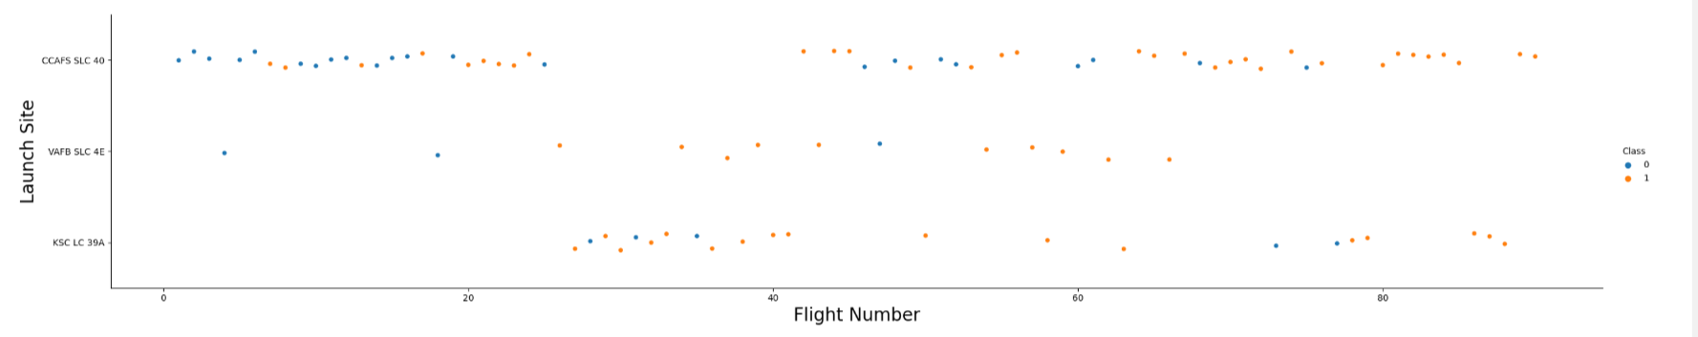
Flight Number vs. Launch Site
Graphic suggests an increase in success rate over time (indicated in Flight Number). Likely a big breakthrough around flight 20 which significantly increased success rate. CCAFS appears to be the main launch site as it has the most volume.

Slide 18
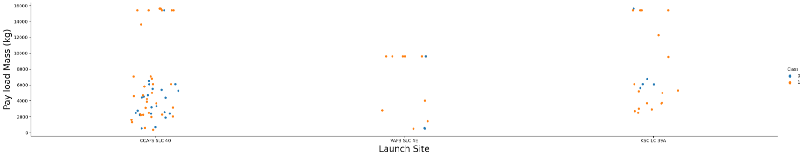
Payload vs. Launch Site
Payload mass appears to fall mostly between 0-6000 kg. Different launch sites also seem to use different payload mass.

Slide 19
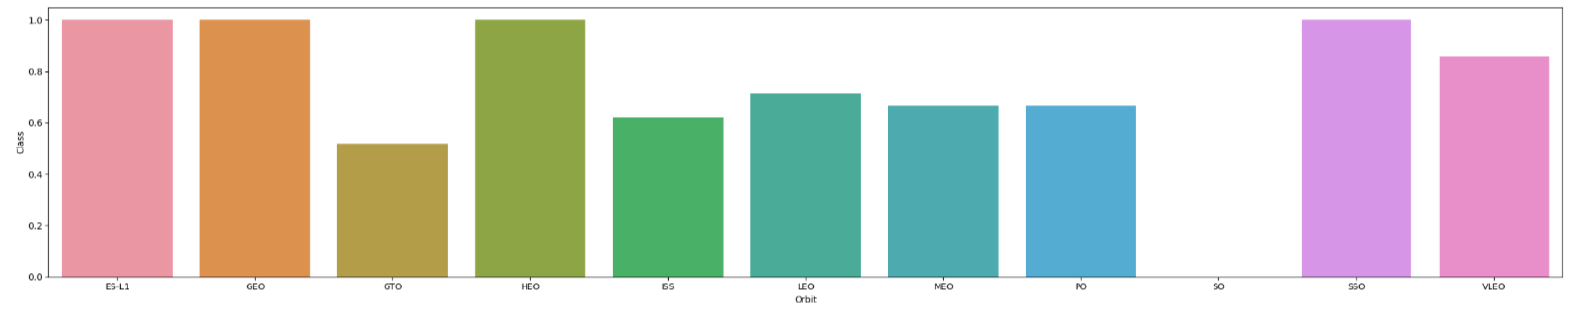
Success Rate vs. Orbit Type
ES-L1 (1), GEO (1), HEO (1) have 100% success rate (sample sizes in parenthesis) SSO (5) has 100% success rate
VLEO (14) has decent success rate and attempts
SO (1) has 0% success rate
GTO (27) has the around 50% success rate but largest sample

Slide 20
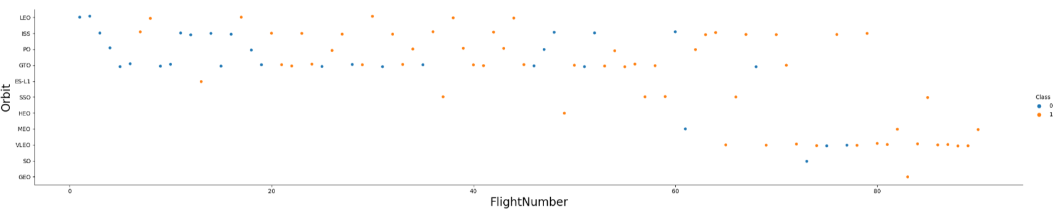
Flight Number vs. Orbit Type
Launch Orbit preferences changed over Flight Number. Launch Outcome seems to correlate with this preference.
SpaceX started with LEO orbits which saw moderate success LEO and returned to VLEO in recent launches SpaceX appears to perform better in lower orbits or Sun-synchronous orbits

Slide 21
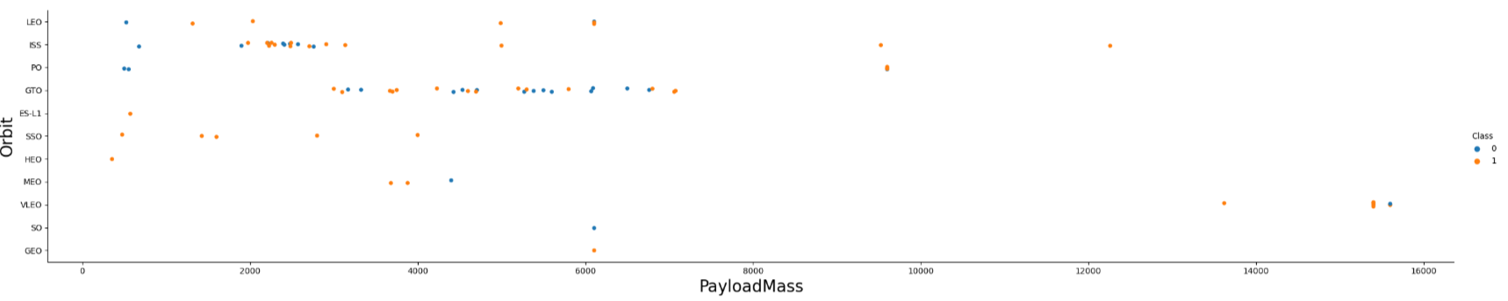
Payload vs. Orbit Type
Payload mass seems to correlate with orbit
LEO and SSO seem to have relatively low payload mass
The other most successful orbit VLEO only has payload mass values in the higher end of the range

Slide 22
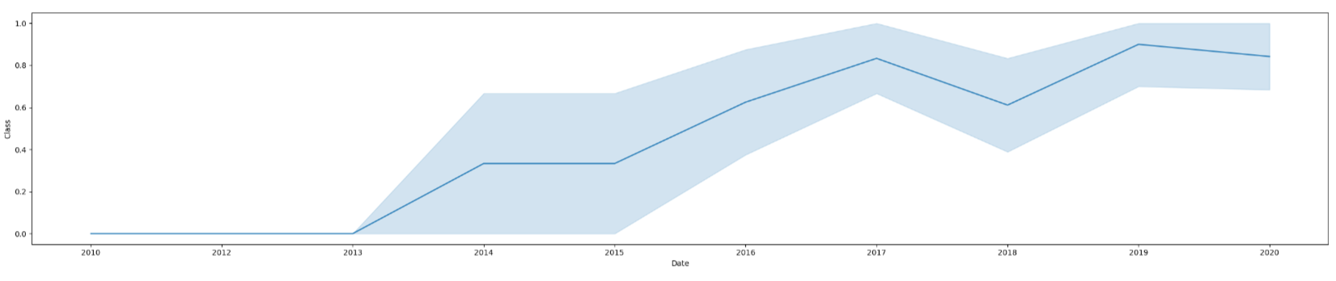
Launch Success Yearly Trend
95% confidence interval (light blue shading)

Slide 23
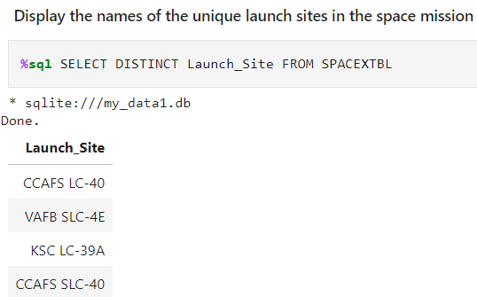
All Launch Site Names
Query unique launch site names from database.
CCAFS SLC-40 and CCAFSSLC-40 likely all represent the same
launch site with data entry errors.
CCAFS LC-40 was the previous name. Likely only 3 unique launch_site values: CCAFS SLC-40, KSC LC-39A, VAFB SLC-4E

Slide 24
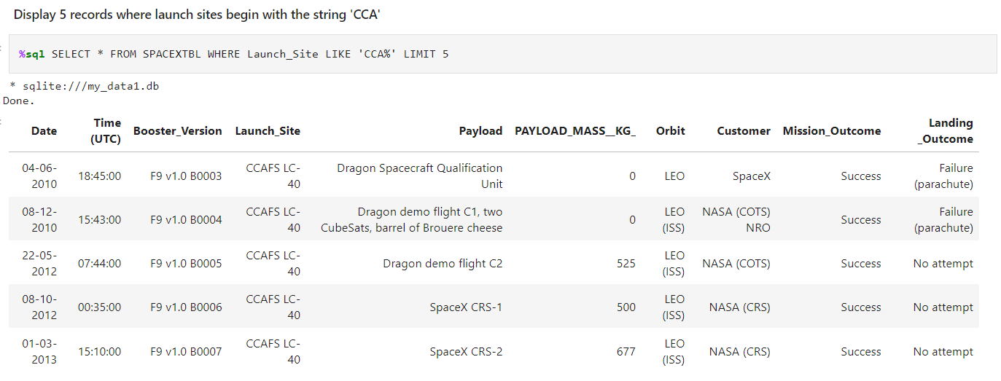
Launch Site Names Begin with 'CCA'
Find 5 records where launch sites begin with `CCA`
Present your query result with a short explanation here

Slide 25
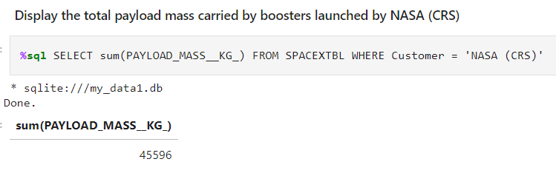
Total Payload Mass
This query sums the total payload mass in kg where NASA was the customer.
CRS stands for Commercial Resupply Services which indicates that these payloads were sent to the International Space Station (ISS).

Slide 26
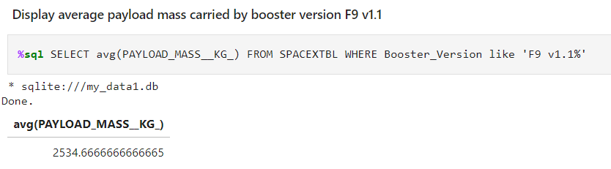
Average Payload Mass by F9 v1.1
This query calculates the average payload mass or launches which used booster version F9 v1.1
Average payload mass of F9 1.1 is on the low end of our payload mass range

Slide 27
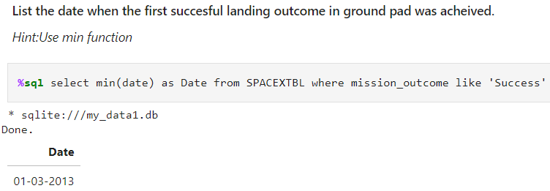
First Successful Ground Landing Date
This query returns the first successful ground pad landing date.
First ground pad landing wasn’t until the end of 2013.

Slide 28
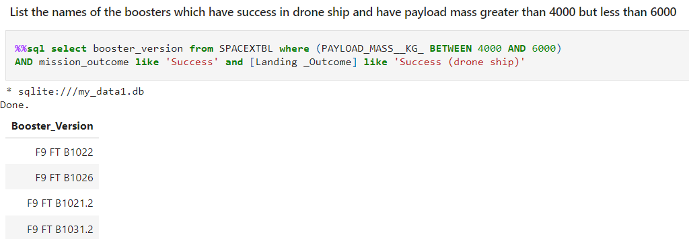
Successful Drone Ship Landing with Payload between 4000 and 6000
List the names of boosters which have successfully landed on drone ship and had payload mass greater than 4000 but less than 6000
Present your query result with a short explanation here

Slide 29
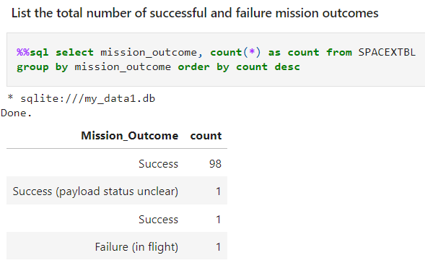
Total Number of Successful and Failure Mission Outcomes
This query returns a count of each
mission outcome.
SpaceX appears to achieve its mission outcome nearly 99% of the time.
This means that most of the landing
failures are intended.
Interestingly, one launch has an unclear payload status and unfortunately one failed in flight.

Slide 30
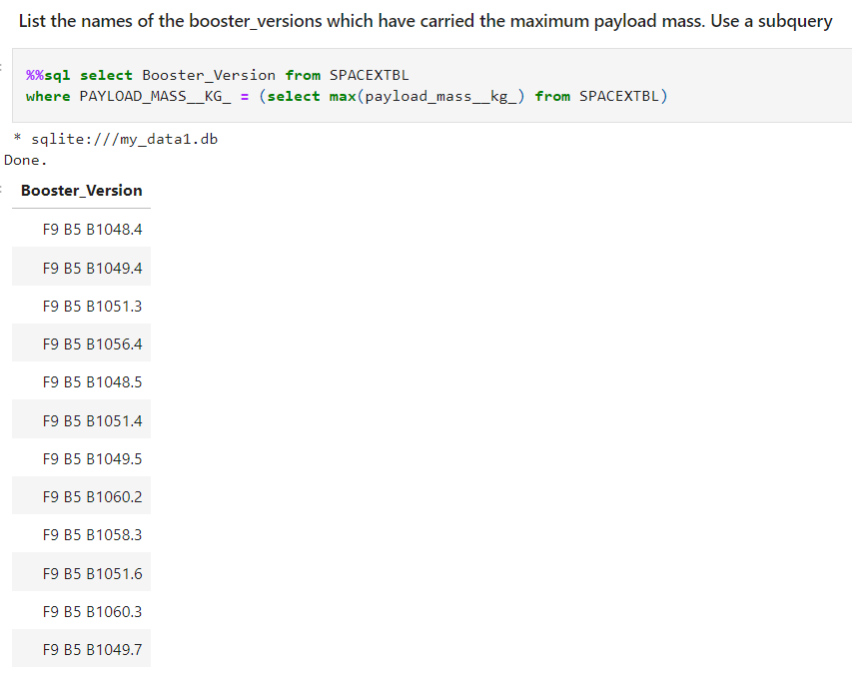
Boosters Carried Maximum Payload
This query returns the booster versions that carried the highest payload mass of 15600 kg.
These booster versions are very similar and all are of the F9 B5 B10xx.x variety.
This likely indicates payload mass correlates with the booster version that is used.

Slide 31
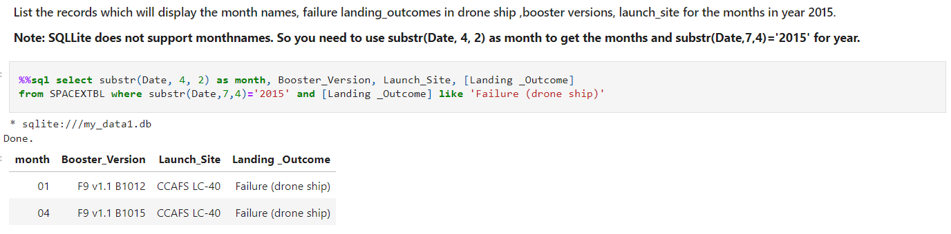
2015 Launch Records
This query returns the Month, Landing Outcome, Booster Version, Payload Mass (kg), and Launch site of 2015 launches where stage 1 failed to land on a drone ship.
There were two such occurrences.

Slide 32
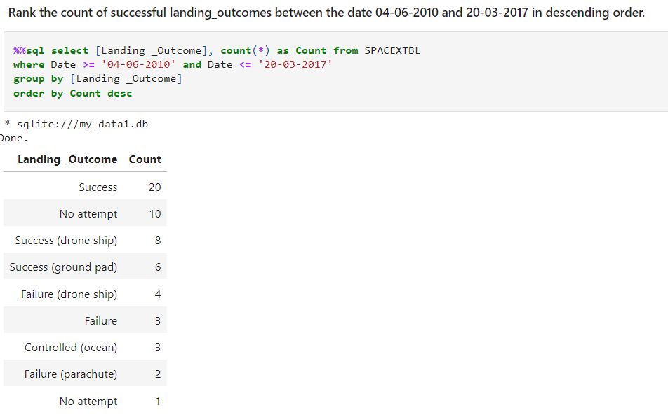
Rank Landing Outcomes Between 2010-06-04 and 2017-03-20
This query returns a list of successful landings and between 2010-06-04 and 2017-03-20 inclusively.
There are two types of successful landing outcomes: drone ship and ground pad landings.
There were 8 successful landings in total during this time period

Slide 33

Section 3

Slide 34
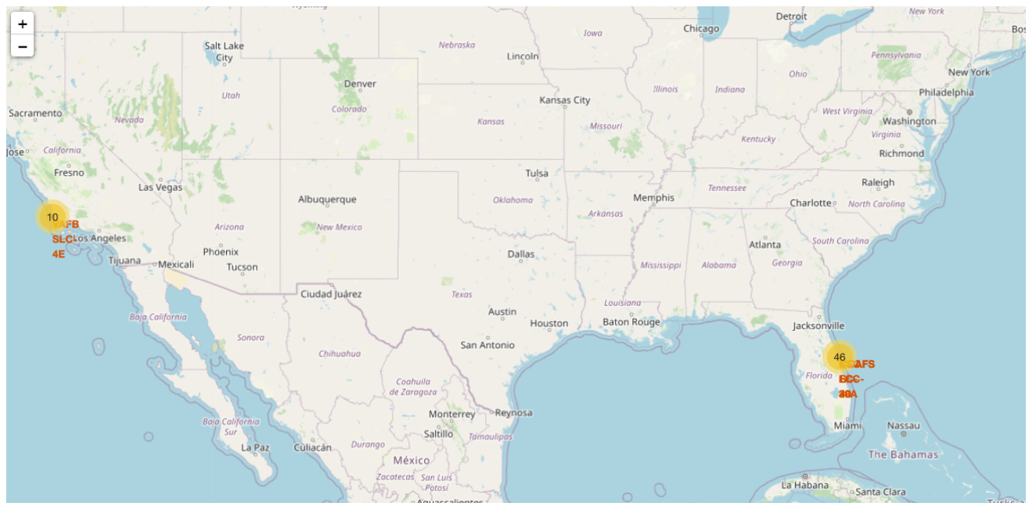
Launch location
map shows the two Florida launch sites since they are very close to each other. All launch sites are near the ocean.

Slide 35
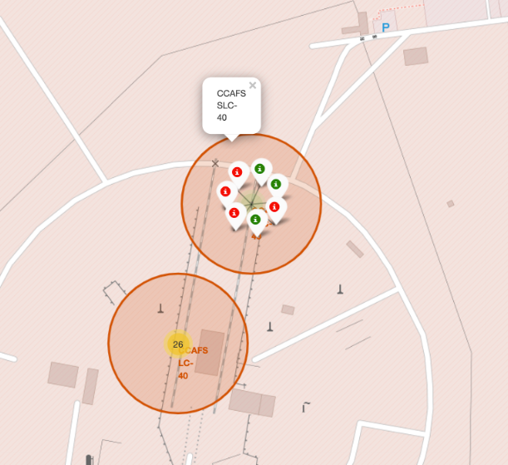
Color marker
Clusters on Folium map can be clicked on to display each successful landing (green icon) and failed
landing (red icon). In this example VAFB SLC-4E shows 4 successful landings and 6 failed landings.

Slide 36
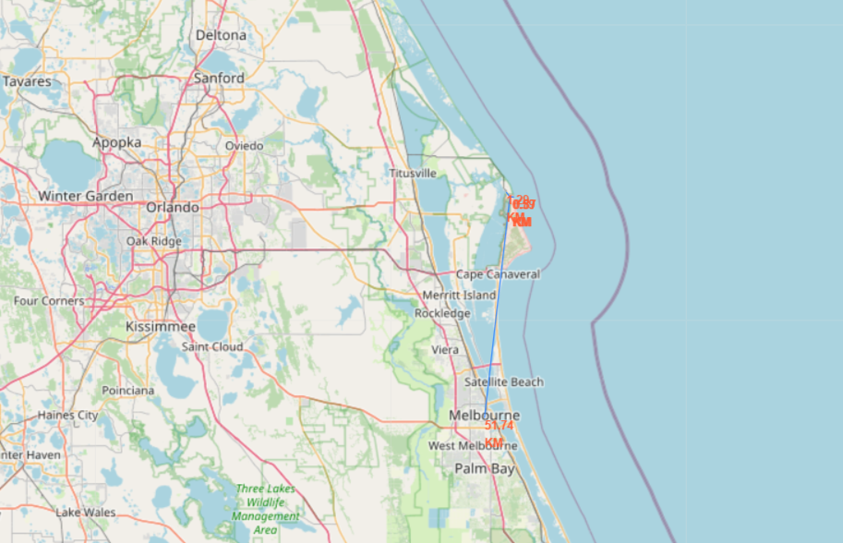
Key Location Proximities
Using KSC LC-39A as an example, launch sites are very close to railways for large part and supply transportation. Launch sites are close to highways for human and supply transport. Launch sites are also close to coasts and relatively far from cities so that launch failures can land in the sea to avoid rockets falling on densely populated areas.

Slide 37

Section 4

Slide 38
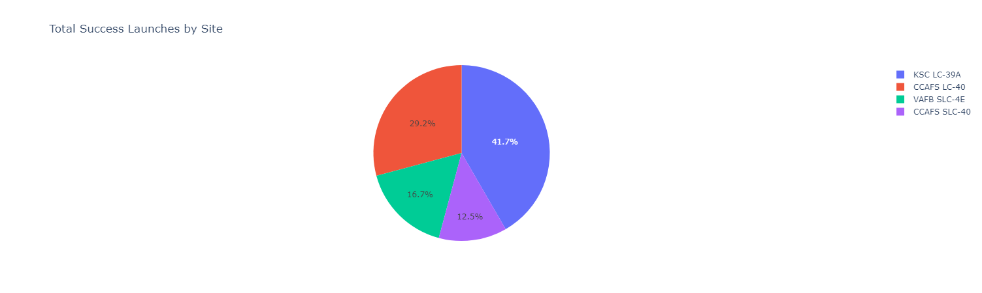
Successful Launches Across Launch Sites
This is the distribution of successful landings across all launch sites. CCAFS LC-40 is the old name of CCAFS SLC-40 so CCAFS and KSC have the same amount of successful landings, but a majority of the successful landings where performed before the name change. VAFB has the smallest share of successful landings. This may be due to smaller sample and increase in difficulty of launching in the west coast.
This is the distribution of successful landings across all launch sites. CCAFS LC-40 is the old name of CCAFS SLC-40 so CCAFS and KSC have the same amount of successful landings, but a majority of the successful landings where performed before the name change. VAFB has the smallest share of successful landings. This may be due to smaller sample and increase in difficulty of launching in the west coast.

Slide 39
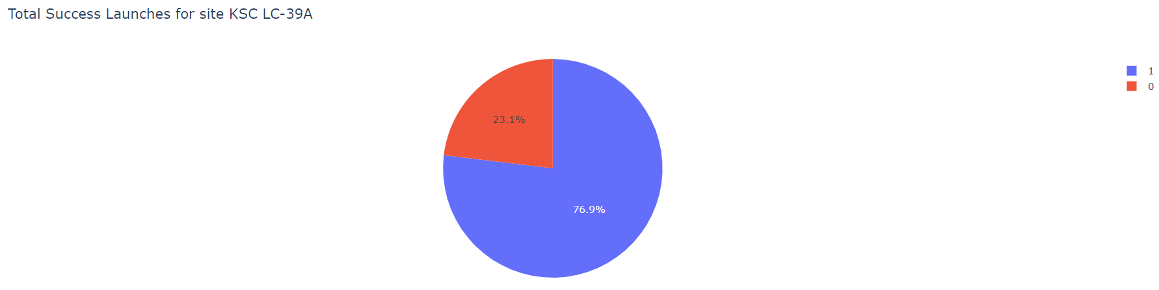
Highest Success Rate Launch Site
Replace <Dashboard screenshot 2> title with an appropriate title
Show the screenshot of the piechart for the launch site with highest launch success ratio
Explain the important elements and findings on the screenshot
KSC LC-39A has the highest success rate with 10 successful landings and 3 failed landings.

Slide 40
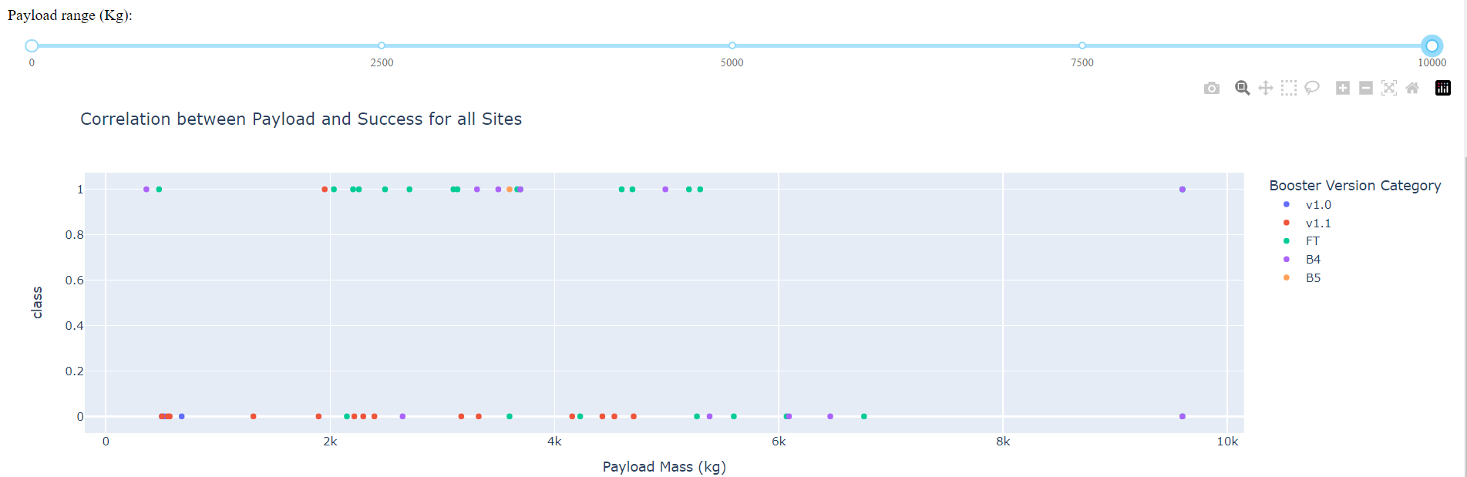
Payload Mass vs. Success vs. Booster Version Category
Plotly dashboard has a Payload range selector. However, this is set from 0-10000 instead of the max Payload of 15600. Class indicates 1 for successful landing and 0 for failure. Scatter plot also accounts for booster version category in color and number of launches in point size.

Slide 41

Section 5

Slide 42
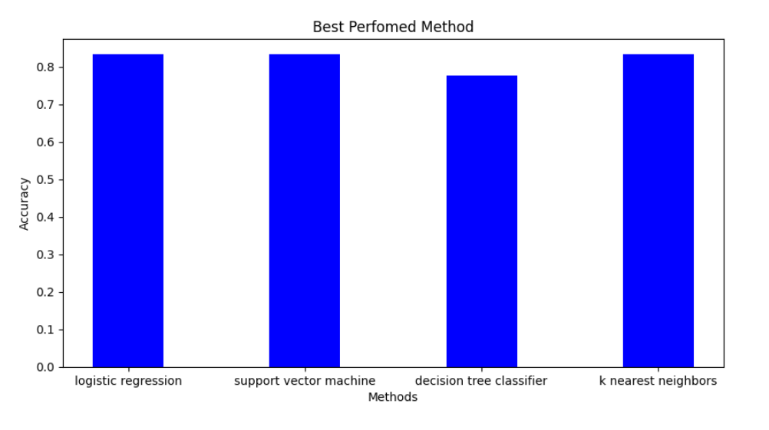
Classification Accuracy
All models had virtually the same accuracy on the test set at 83.33% accuracy.
It should be noted that test size is small at only sample size of 18

Slide 43
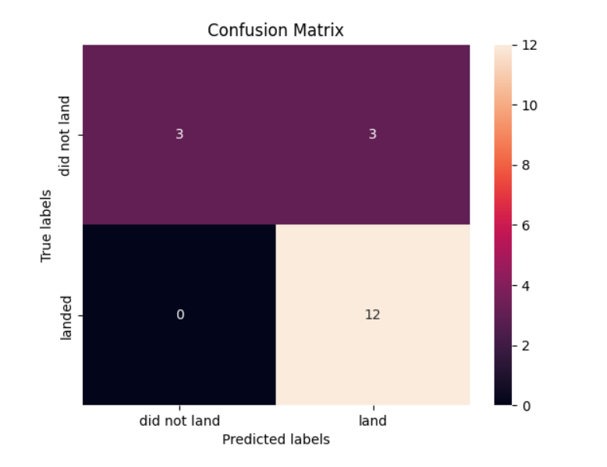
Confusion Matrix
Since all models performed the same for the test set, the confusion matrix is the same across all models. The models predicted 12 successful landings when the true label was successful landing.
The models predicted 3 unsuccessful landings when the true label was unsuccessful landing.
The models predicted 3 successful landings when the true label was unsuccessful landings (false positives). Our models over predict successful landings.

Slide 44
Conclusions
The goal of model is to predict when Stage 1 will successfully land to save ~$100 million USD
We created a machine learning model with an accuracy of 83% e.g. logistics regression, SVM and K-nearest neighbour.
Anyone can use this model to predict with relatively high accuracy whether a launch will have a successful Stage 1 landing before launch to determine whether the launch should be made or not
If possible more data should be collected to better determine the best machine learning model and improve accuracy

Slide 45


